Slide 1
Community Detection from Research Papers
Hitesh Sharma (201301065)
Kanika Kanwal (201505526)
Tummalapalli Madhuri (201325191)

Slide 2
Problem Statement
Research papers are represented in the form of a network or a graph.
The nodes represent the participating entities, or in this case, research papers or their authors.
The edges represent the relations between these entities.
The task is to detect communities within this network of research articles.

Slide 3
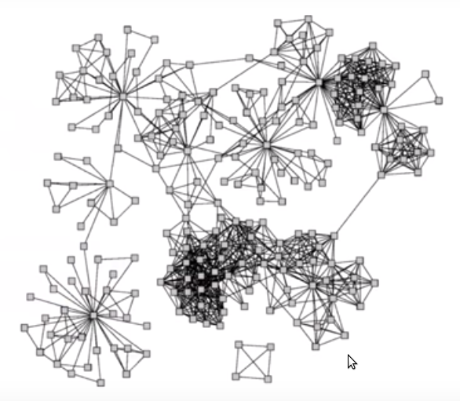
Network Communities
A network is said to have community structure if the nodes of the network can be easily grouped into sets of nodes such that each set of nodes is densely connected internally.
A network community has the following properties -
Mutuality of Ties
Compactness
Density of Edges
Separation

Slide 4
Network Graph Construction
For this project, we constructed a network graph from the available data using two weak metrics, and two strong ones.
Weaker Metrics - Paper Titles, Year of Publication
Stronger Metrics - Paper Citations, Author Citations
Dataset used - AAN (http://clair.eecs.umich.edu/aan/index.php)

Slide 5
Community Detection as a Graph clustering problem
This consists majorly of two steps :
Define a similarity measure and find the similarity between each pair of nodes.
Cosine Similarity
Jaccard Similarity
Group similar nodes together.
K-Means Algorithm

Slide 6
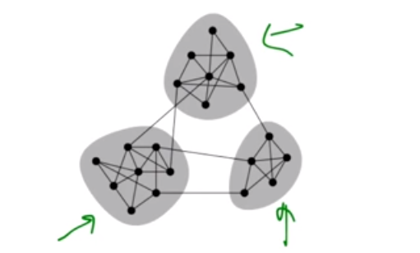
Community Detection as a Graph partitioning problem
Graph partitioning algorithms find communities based on the structural similarity of nodes in the graph.
We will look at two algorithms -
Newman-girvan algorithm
Based on edge-betweenness
Louvain algorithm
Based on maximising modularity

Slide 7
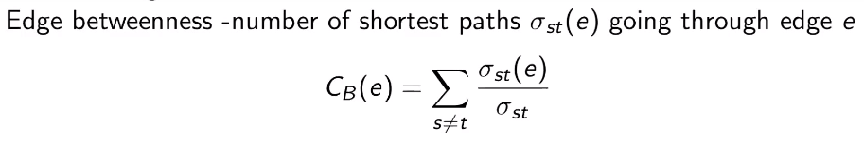
Newman-Girvan Algorithm
This algorithm focuses on the edges that connect the communities. It is based on the simple idea that the shortest path between nodes belonging to different communities will always include the edges linking the communities.
The edges with the highest betweenness value are removed from the graph, and as a result the graph may split into multiple components. Each component can be thought of as a network community. The algorithm proceeds as long as edges remain in the graph.

Slide 8
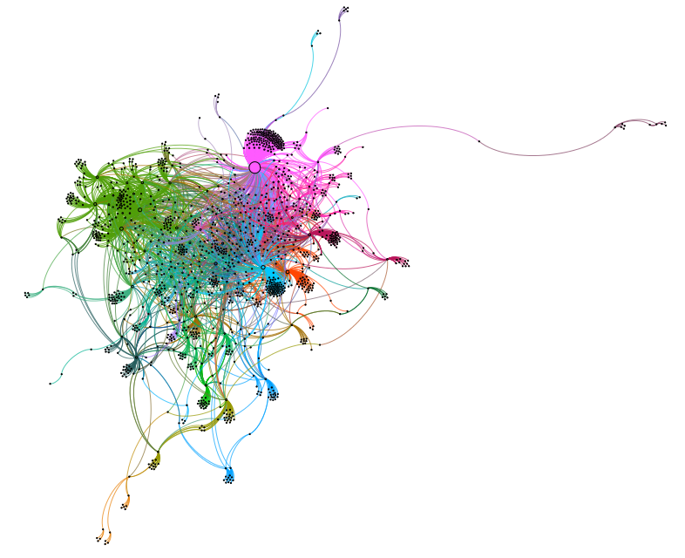
Newman-Girvan
Communities in an unweighted Author Citation network.

Slide 9
Louvain Algorithm
The Louvain algorithm partitions the graph by optimising the graph modularity measure.
The algorithm iterates through two major steps:
Initially, every node is in its own community. Iterate over every node, and add it to the community that results in the highest modularity. Change in modularity:
All the nodes in a given community (formed till now) are grouped together to form a single node in a new network. Repeat again on this network.

Slide 10
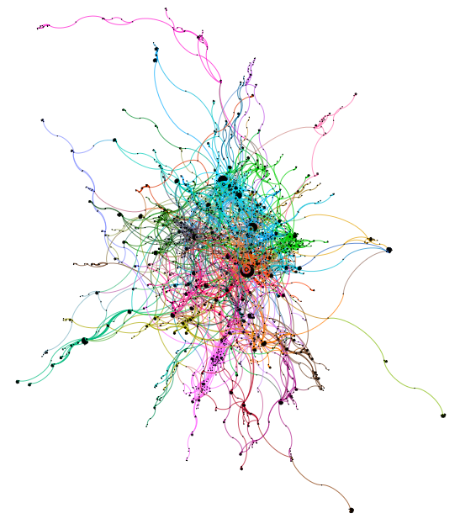
Louvain
Communities in a weighted Paper Citation network.

Slide 11
References
Vincent D. Blondel, Jean-Loup Guillaume, Renaud Lambiotte and Etienne Lefebvre; Fast unfolding of communities in large networks (2008)
M. E. J. Newman; Detecting community structure in networks
http://www-personal.umich.edu/~mejn/papers/epjb.pdf
Gephi tool
https://gephi.org/
Charu C. Aggarwal, Yan Xie and Philip S. Yu; Towards Community Detection in Locally Heterogeneous Networks
https://en.wikipedia.org/wiki/Louvain_Modularity
https://en.wikipedia.org/wiki/K-means_clustering
https://www.youtube.com/watch?v=lU1QEUH0nNc

Slide 12
Thank You

